Slide 1
THE SECRET OF PARIS
PRIVATE TOURS & CONCIERGE EXPERIENCES DESIGNED EXCLUSIVELY FOR YOU
Editorial Luxury Collection

Slide 2
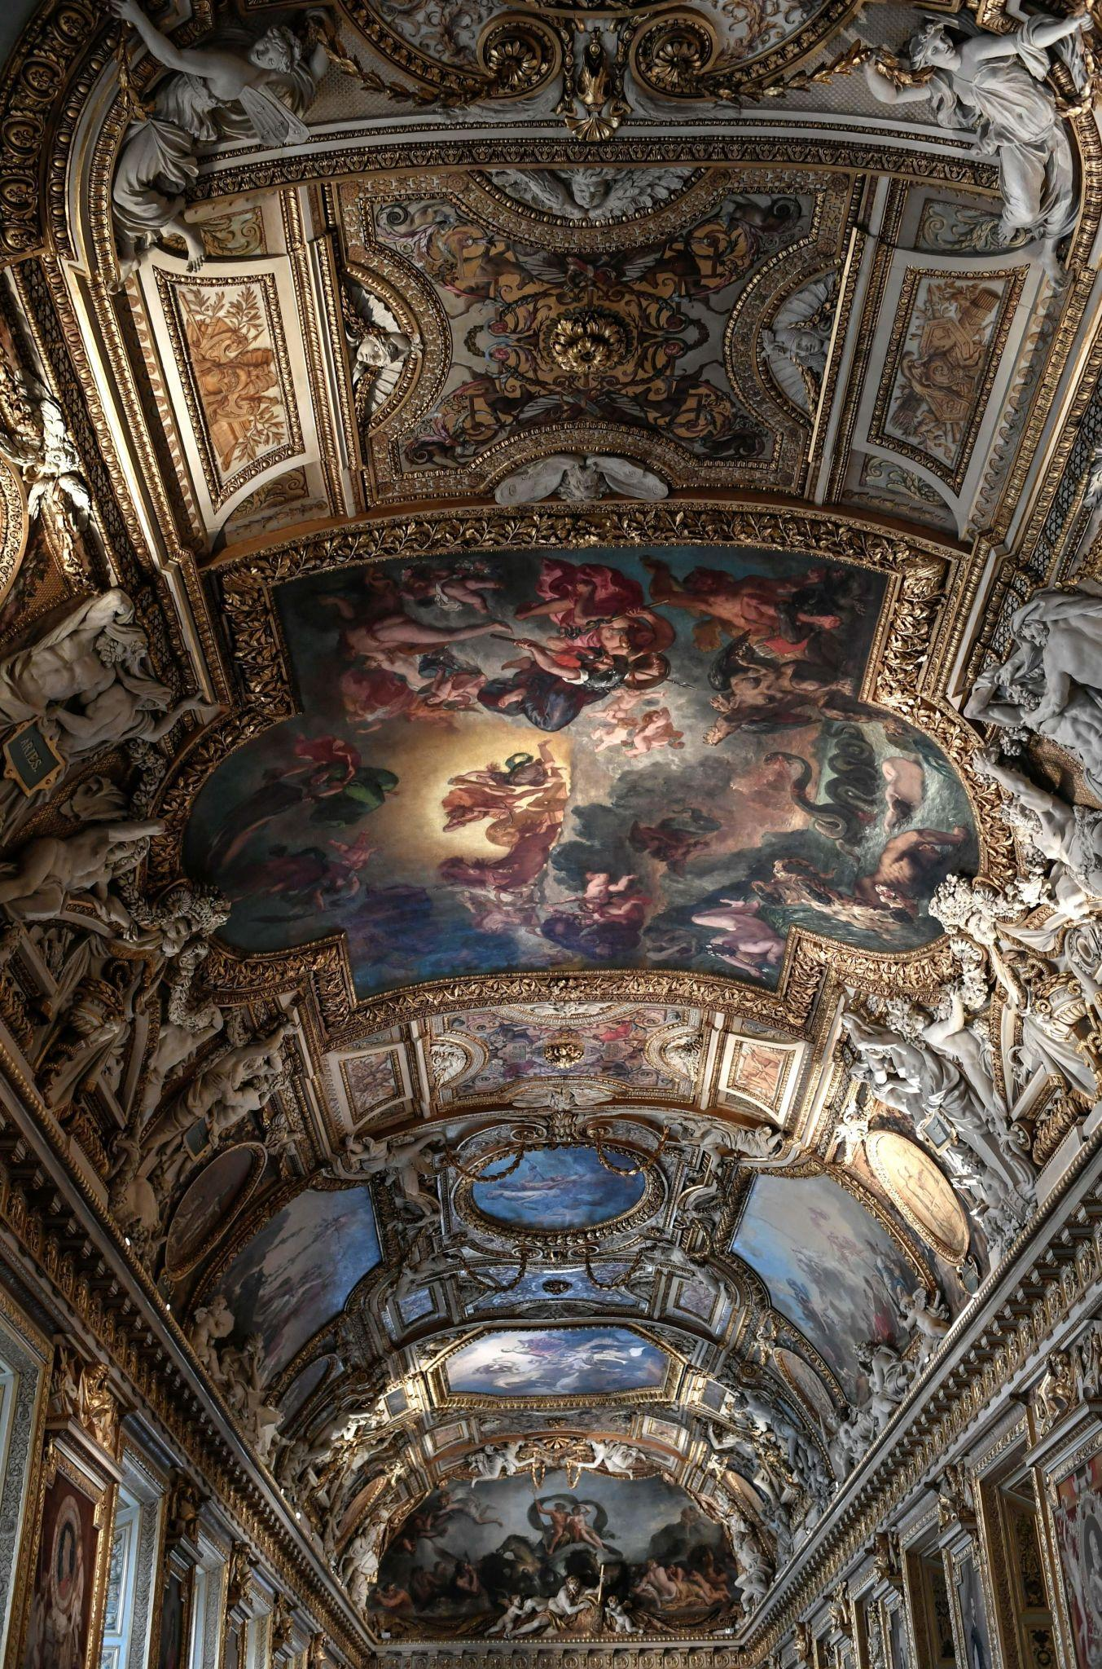
IMAGE — THE LOUVRE HIGHLIGHTS
THE LOUVRE
PRIVATE ART JOURNEY
Discover the world’s greatest masterpieces through a private artistic journey
3 hours • 1–6 guests
INCLUDED
Hotel pick up • Expert guide • Private tour • Timed skip‑the‑line • Wheelchair accessible • Tickets included • Artistic storytelling and cultural insights
From €549 (groupe of 1-2 guests)
• €50 every additional guest
OPTIONS
Transfert (Mercedes Class A and E, Porsche) +€190
VIP access +€300

Slide 3
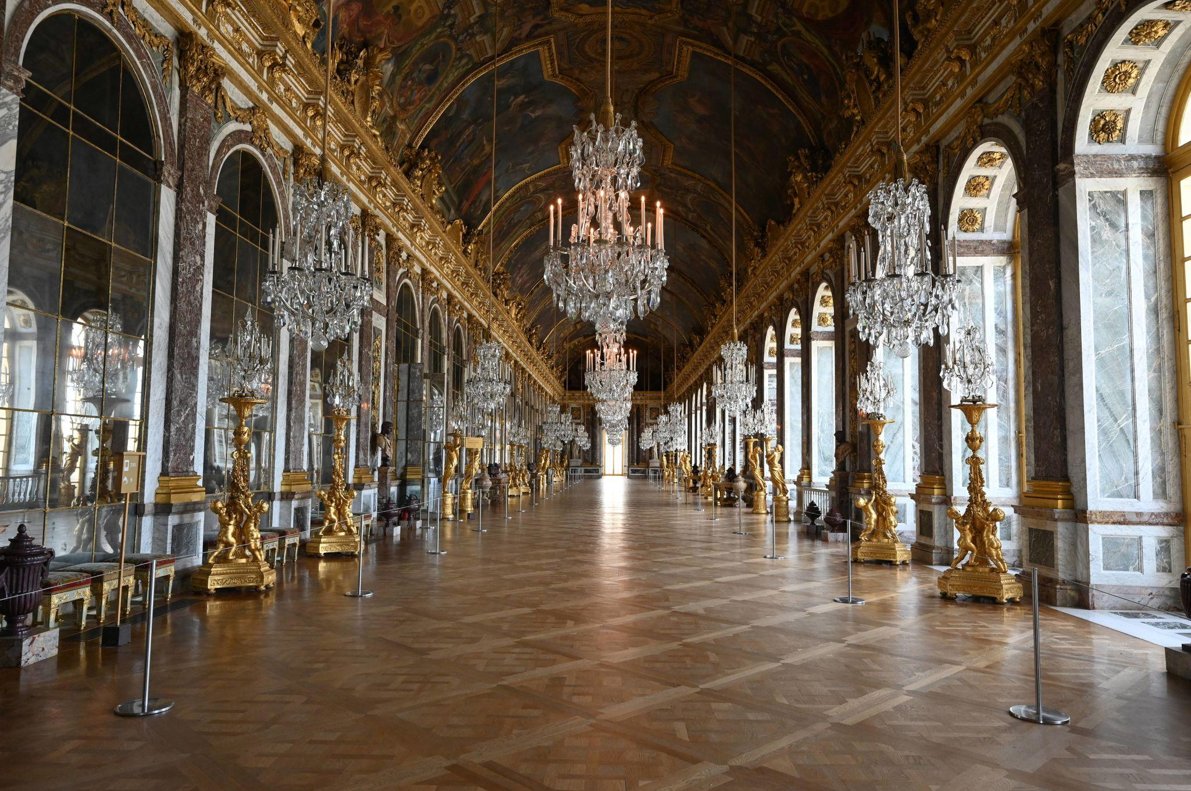
VERSAILLES PRIVATE ROYAL EXPERIENCE
IMAGE — VERSAILLES PRIVATE TOUR
Step into the grandeur of French royalty, away from the crowds.
5 hours • 1–12 guests
INCLUDED
Hotel pick up • Expert guide • Private tour •Timed skip‑the‑line • Wheelchair accessible • Immersive historical and artistic insights
From €749 (groupe of 1-2 guests)
• €80 every additional guest
OPTIONS
Versailles garden visit with Golf cart +€100
Transfert (Mercedes Class A and E, Porsche) +€300

Slide 4
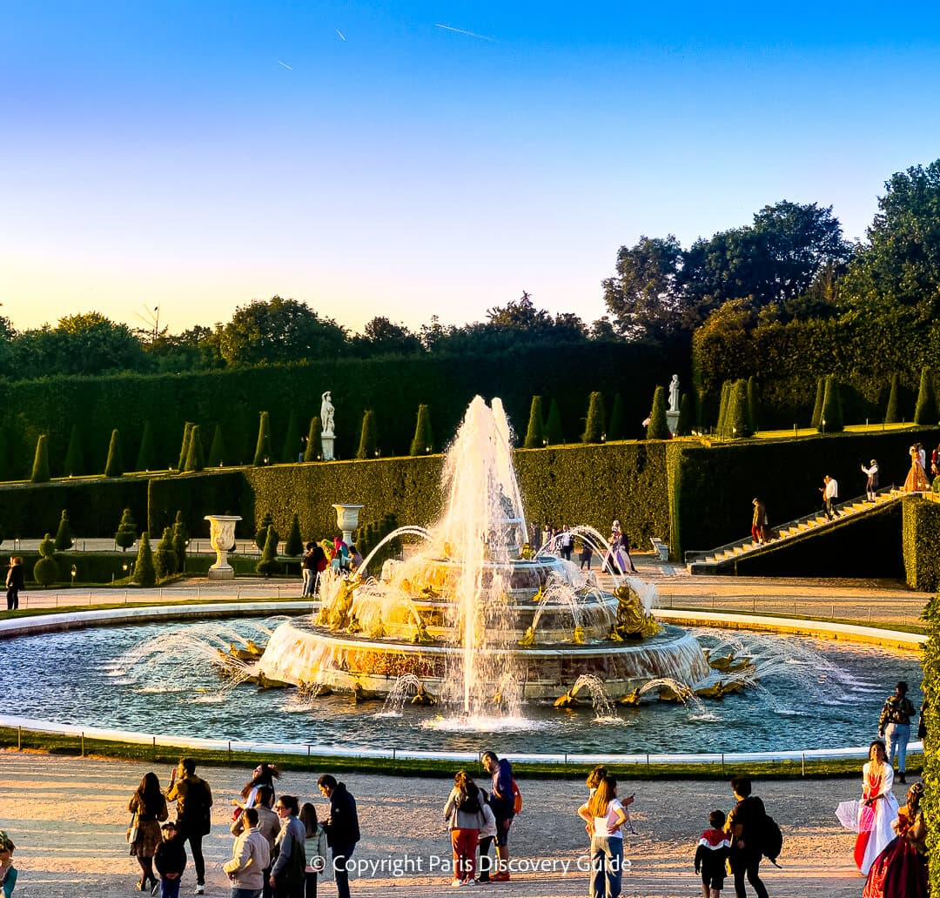
IMAGE — VERSAILLES FULL DAY
VERSAILLES FULL DAY ROYAL JOURNEY
A full day immersed in the elegance and grandeur of Versailles
8 hours • 1–12 guests
INCLUDED
Hotel pick up • Expert guide • Private tour •Timed entrance • Palace, Gardens & Marie Antoinette's Trianon • Wheelchair accessible • Artistic storytelling and cultural insights
From €1079 (groupe of 1-2 guests)
• €100 every additional guest
OPTIONS
Versailles garden visit with Golf cart +€100
Transfert (Mercedes Class A and E, Porsche) +€300

Slide 5
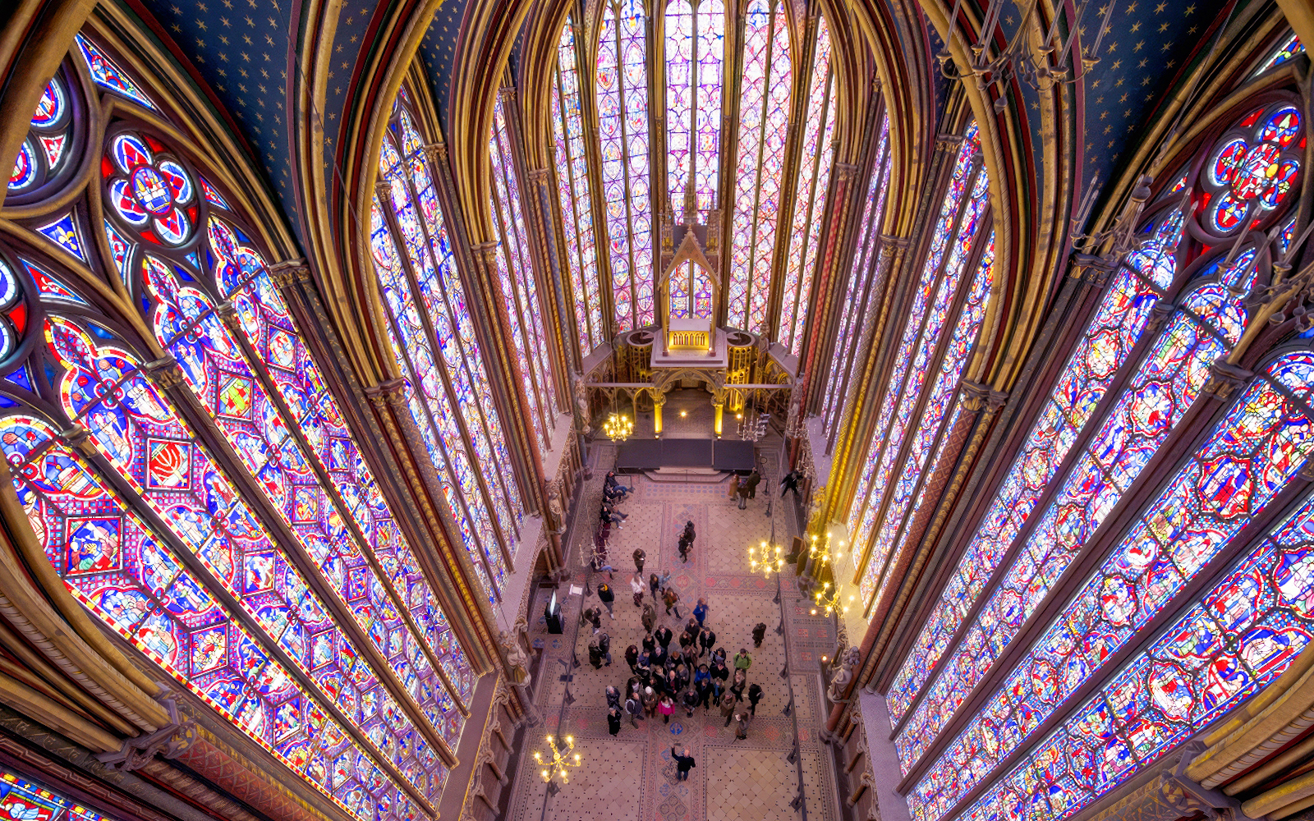
NOTRE-DAME & SAINTE-CHAPELLE — GOTHIC MASTERPIECES EXPERIENCE
IMAGE — FONTAINEBLEAU PRIVATE TOUR
Step into the light and history of Paris’s most breathtaking Gothic treasures
3 hours • 1–5 guests
INCLUDED
Hotel pick up • Private tour • Expert guide • Skip‑the‑line tickets • Wheelchair accessible • Artistic storytelling and cultural insights
From €629 (groupe of 1-2 guests)
€30 every additional guest
Transfert (Mercedes Class A and E, Porsche) +€190

Slide 6
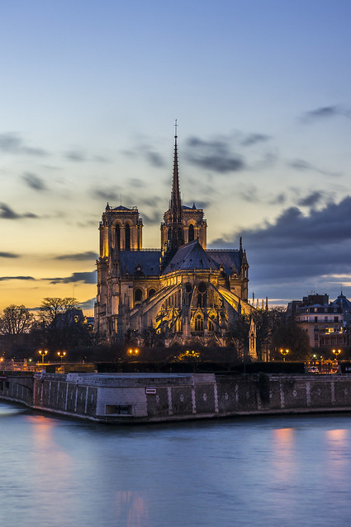
IMAGE — NOTRE‑DAME DE PARIS
NOTRE‑DAME
TIMLESS PARIS
Eight centuries of history reborn at the heart of Paris
3 hours • 1–5 guests
INCLUDED
Pick up at your hotel • Private tour • Expert local guide • Wheelchair accessible • Immersive historical and artistic insights
From €449 (groupe of 1-2 guests)
€30 every additional guest
Transfert (Mercedes Class A and E, Porsche) +€190

Slide 7
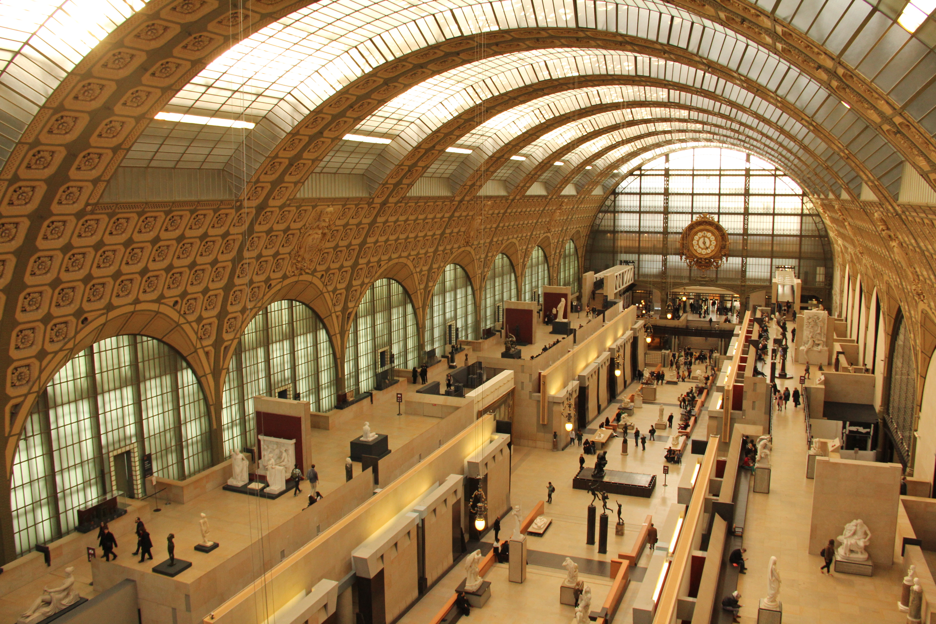
MUSÉE D’ORSAY & THE IMPRESSIONIST EXPERIENCE
IMAGE — MUSÉE D’ORSAY & IMPRESSIONISM
Meet the artists who changed the way the world sees light and color
3 hours • 1–6 guests
INCLUDED
Expert guide • Timed skip‑the‑line • Private tour • Hotel pick up • Wheelchair accessible • Tickets included
From €579 (groupe of 1-2 guests)
• €50 every additional guest
Transfert (Mercedes Class A and E, Porsche) +€190

Slide 8
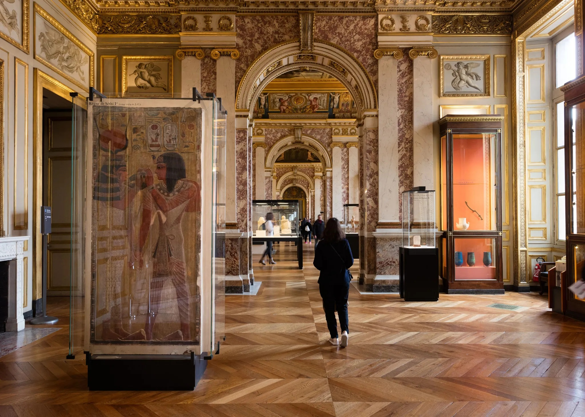
IMAGE — THE LOUVRE HIGHLIGHTS
THE LOUVRE
FAMILY TREASURE EXPERIENCE
A playful journey through the Louvre designed to inspire young explorers
2 hours • 1–6 guests
INCLUDED
Hotel pick up • Private tour • Family-friendly guide• Interactive treasure hunt cross the Louvre• Activity booklet and games for children• Skip-the-line entrance tickets• Small surprises for young explorers
From €549 (groupe of 1-2 guests)
• €30 every additional guest
OPTIONS
VIP access +€300
Transfert (Mercedes Class A and E, Porsche) +€190

Slide 9
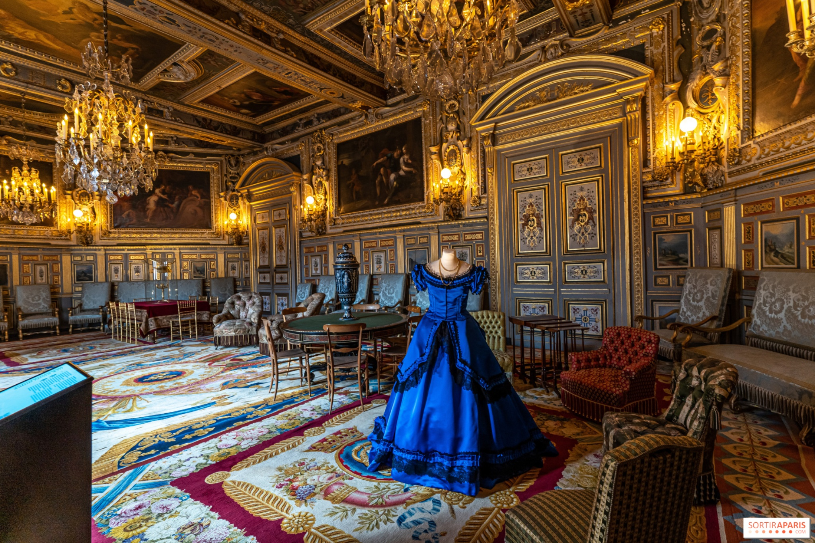
FONTAINEBLEAU PRIVATE ROYAL JOURNEY
IMAGE — FONTAINEBLEAU PRIVATE TOUR
Step into the quiet elegance of France’s most intimate royal palace
5 hours • 1–10 guests
INCLUDED
Private tour • Hotel pick up • Expert guide • Priority entrance tickets • Palace & Garden • Wheelchair accessible
From €690 (groupe of 1-2 guests)
€50 every additional guest
Transfert (Mercedes Class A and E, Porsche) +450

Slide 10
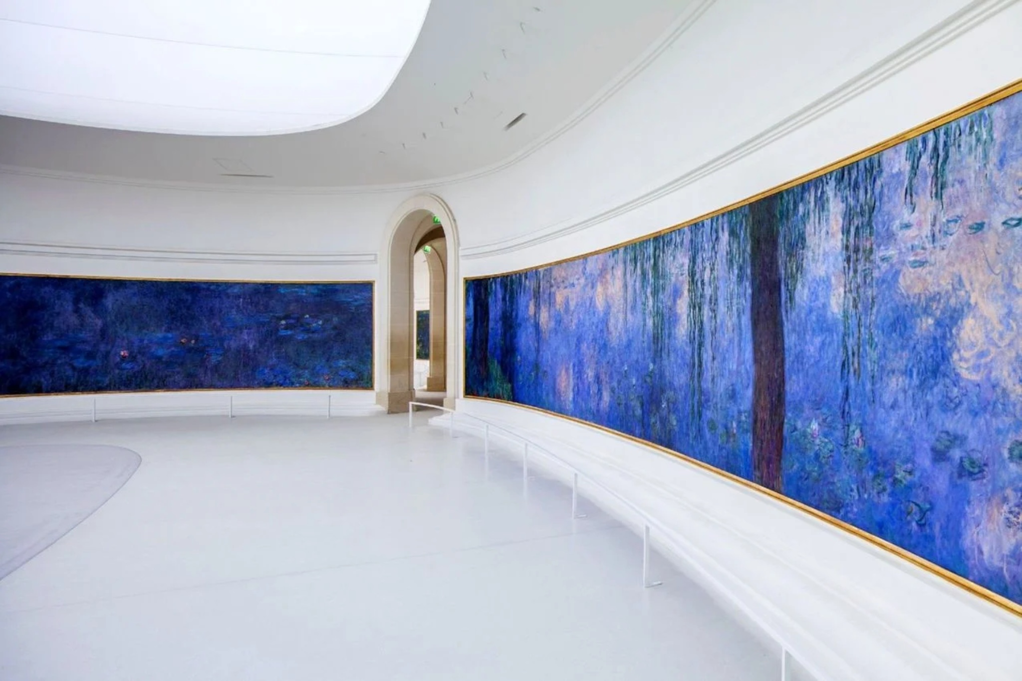
IMAGE — THE LOUVRE HIGHLIGHTS
THE ORANGERIE — MONET'S WATER LILIES & MODERN ART EXPERIENCE
From Monet’s Water Lilies to modern masterpieces, experience art in an intimate setting
2 hours • 1–6 guests
INCLUDED
Hotel pick up • Private tour • Private family-friendly guide• Priority entrance tickets • Artistic storytelling and cultural insights
From €549 (groupe of 1-2 guests)
€50 every additional guest
Transfert (Mercedes Class A and E, Porsche) +€190

Slide 11
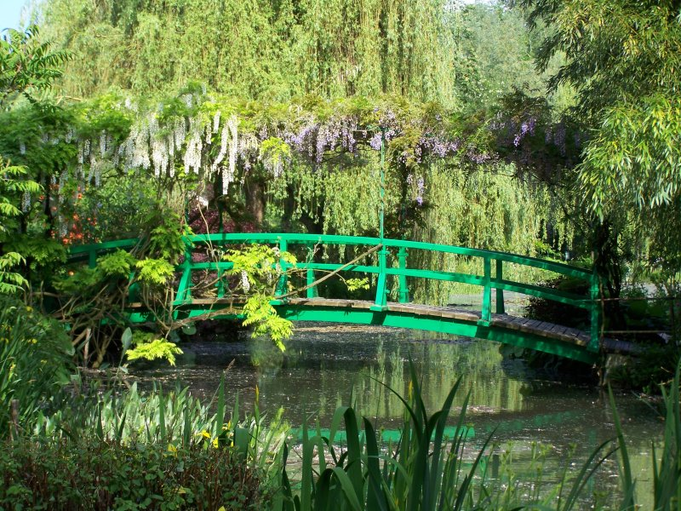
GIVERNY — MONET’S PRIVATE GARDEN EXPERIENCE
IMAGE — MUSÉE D’ORSAY & IMPRESSIONISM
Walk through the landscapes that inspired Monet’s
most iconic paintings
6 hours • 1–6 guests
INCLUDED
Hotel pick up • Private guide specialized in Impressionism • Visit of Monet’s house and gardens • Artistic storytelling and cultural insights • Priority entrance tickets
From €690 (groupe of 1-2 guests)
€50 every additional guest
Transfert (Mercedes Class A and E, Porsche) +€450

Slide 12
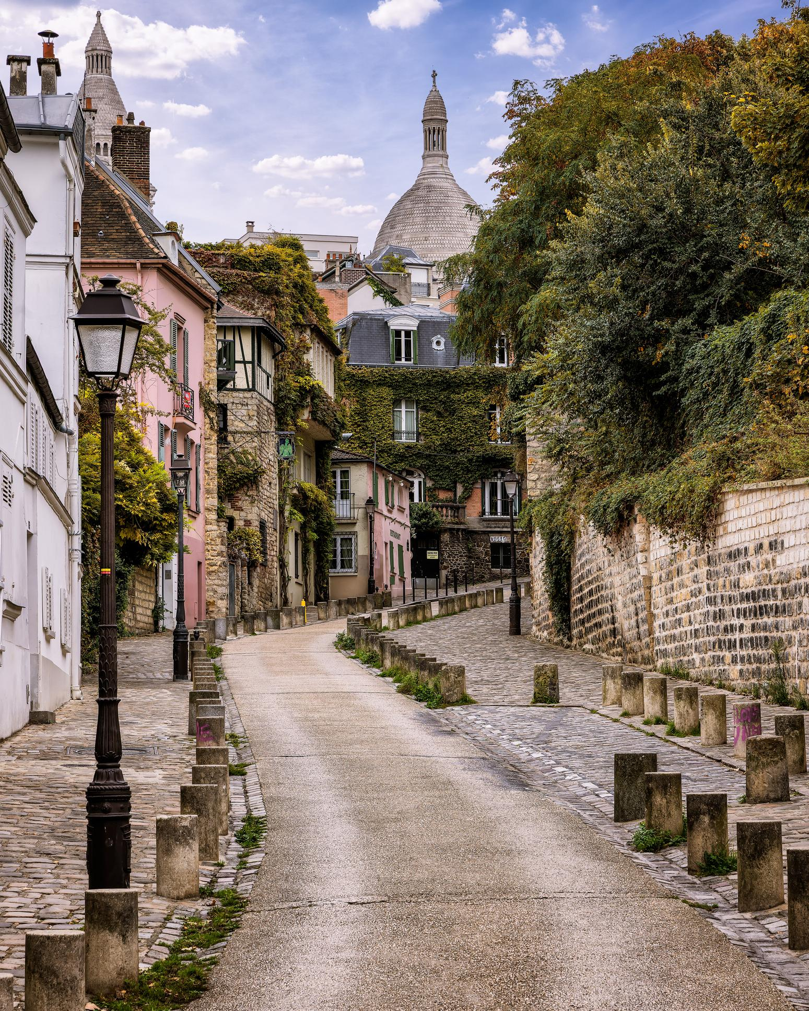
IMAGE — MONTMARTRE WALKING TOUR
THE ARTIST'S MONTMARTRE
Where Paris still feels like an artist’s secret village.
3 hours • 1–12 guests
INCLUDED
Expert guide • Private tour • Hotel pick up • Musée de Montmartre visit and priority tickets included • Artistic storytelling and cultural insights
From €449 (groupe of 1-2 guests)
€30 every additional guest
Transfert (Mercedes Class A and E, Porsche) +€250

Slide 13
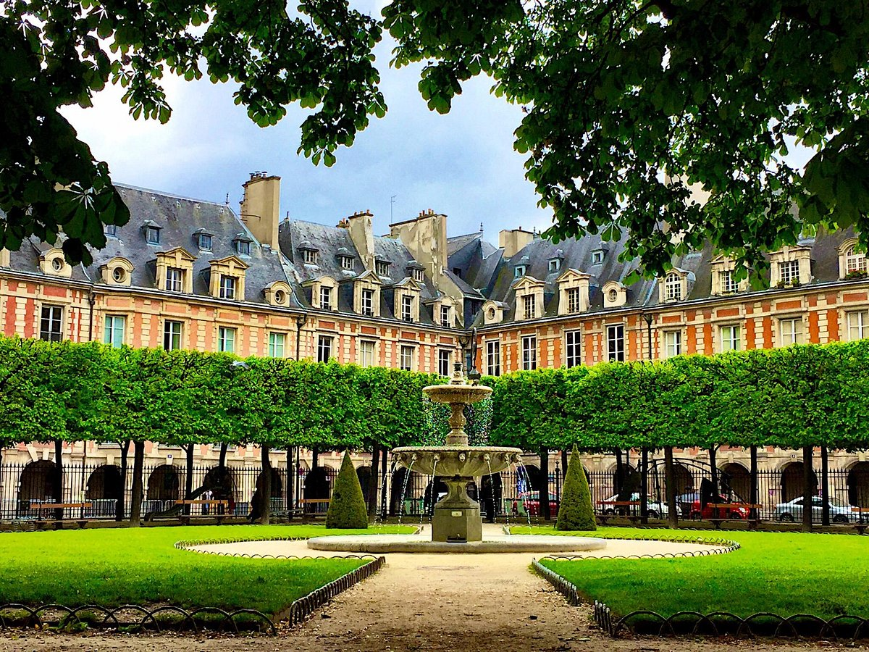
THE MARAIS – PARISIAN PRIVATE LIFESTYLE EXPERIENCE
IMAGE — MUSÉE D’ORSAY & IMPRESSIONISM
From hidden courtyards to elegant boutiques,
experience Paris like an insider
3 hours • 1–12 guests
INCLUDED
Hotel pick up • Private guide • • Artistic storytelling and historical insights
From €449 (groupe of 1-2 guests)
€30 every additional guest
Transfert (Mercedes Class A and E, Porsche) +€190

Slide 14
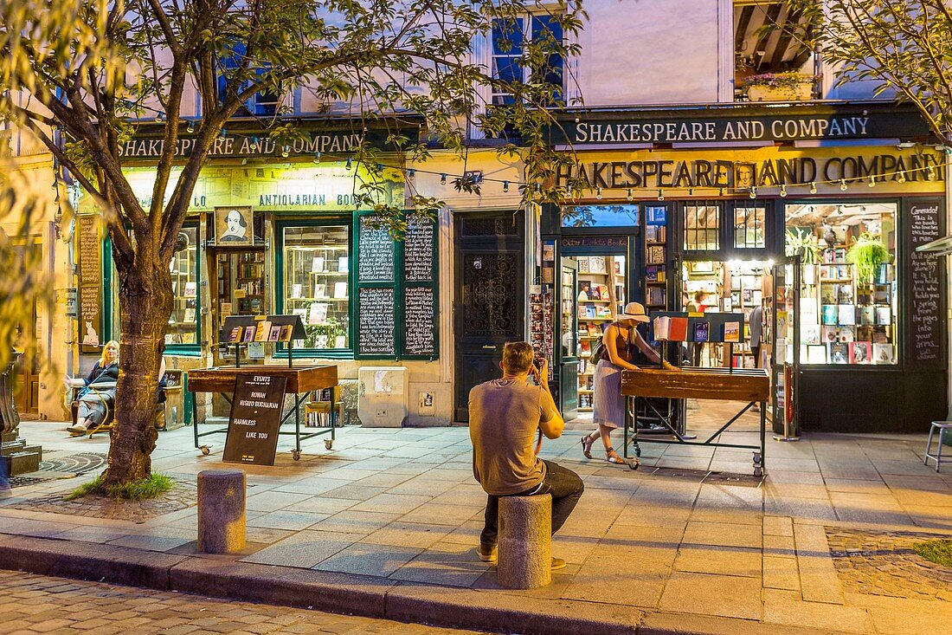
IMAGE — MONTMARTRE WALKING TOUR
LATIN QUARTER
THE HEART OF OLD PARIS
Discover the timeless charm of Paris’s oldest district,
filled with hidden streets and historic landmarks
3 hours • 1–12 guests
INCLUDED
Expert guide • Private tour • Hotel pick up • Artistic storytelling and historical insights
From €449 (groupe of 1-2 guests)
€30 every additional guest
Transfert (Mercedes Class A and E, Porsche) +€190

Slide 15
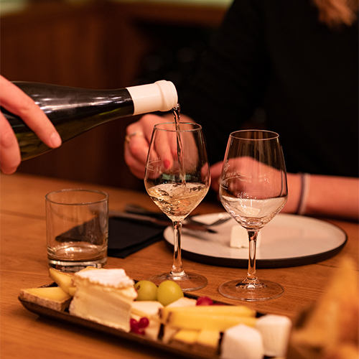
PARISIAN GASTRONOMY EXPERIENCE
IMAGE — PRIVATE FOOD TOUR IN LE MARAIS
Taste Paris like a local, savor it like a connoisseur.
3 hours • 1–9 guests
INCLUDED
Private tour • Expert local guide • Hotel pick up • French pâtisseries & wine included • Wheelchair accessible
From €579 (groupe of 1-2 guests)
€100 every additional guest
Transfert (Mercedes Class A and E, Porsche) +€190

Slide 16
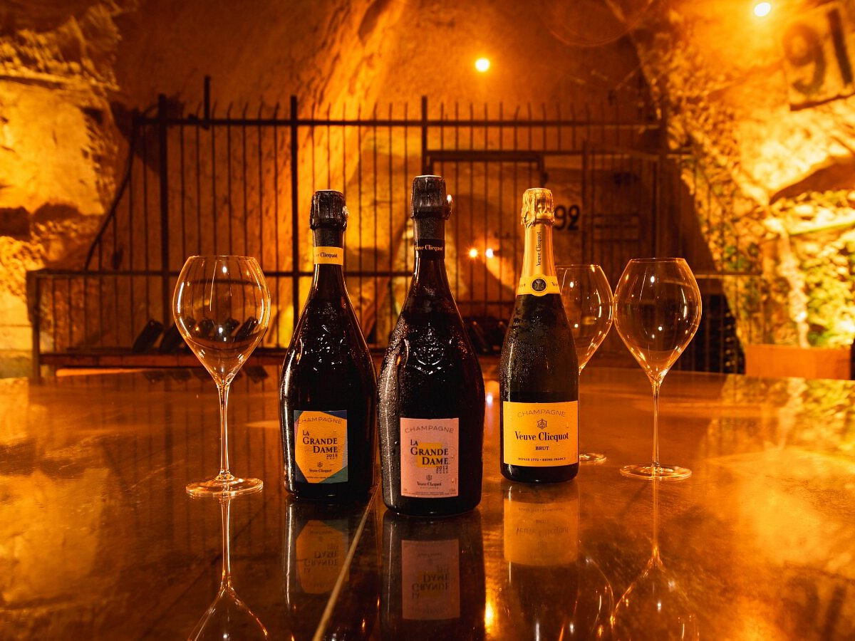
IMAGE — MONTMARTRE WALKING TOUR
CHAMPAGNE — FROM ROYAL CELLARS TO PRIVATE TASTINGS
An exclusive escape through rolling vineyards
and historic maisons de Champagne
8 hours • 1–7 guests
INCLUDED
Dedicated private guide • Hotel pick up and return • Guided exploration of historic Reims • Hosted cellar visits • Signature champagne tastings • Expert wine interpretation & heritage insights
From €1249 (groupe of 1-2 guests)
€100 every additional guest
Transfert (Mercedes Class A and E, Porsche) +€600

Slide 17
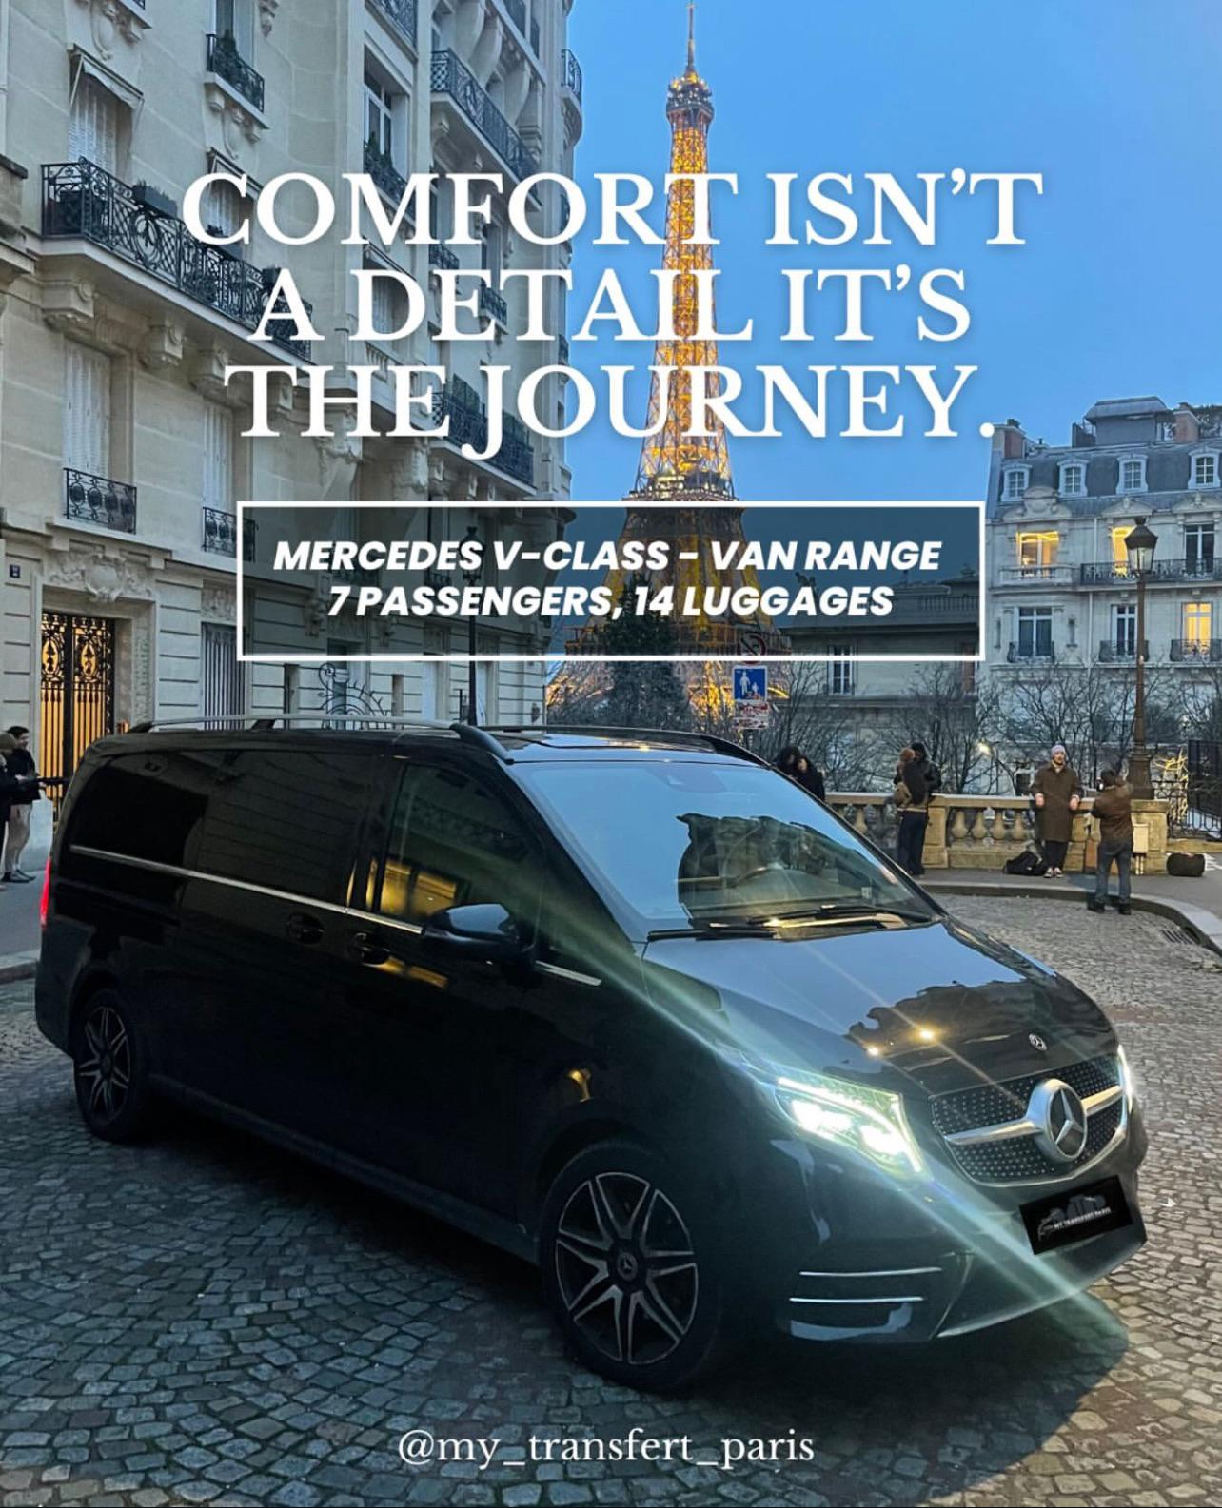
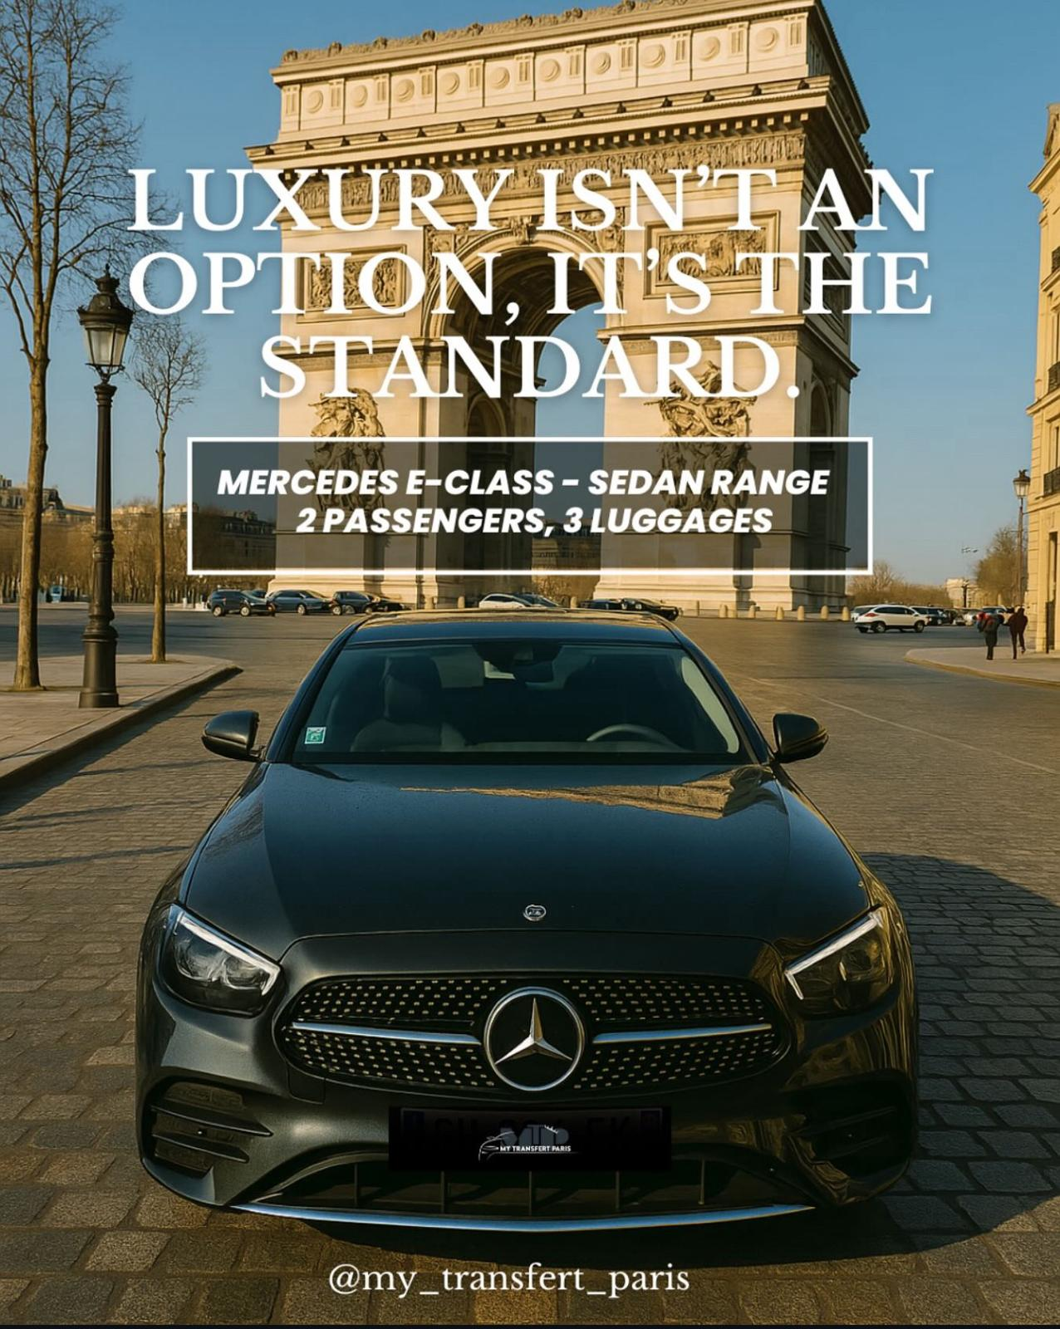
IMAGE — MONTMARTRE WALKING TOUR
Fro

Slide 18
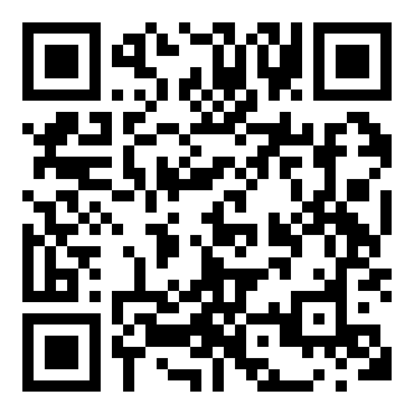
CONTACT
www.thesecretofparis.com
Hello@thesecretofparis.com
+33637476738
Scan to explore our private experiences

Slide 19
Let’s create unforgettable experiences
www.thesecretofparis.com

